Slide 1
Sponsorships & Ads

Slide 2
Platinum Sponsors

Slide 5
Gold Sponsor

Slide 7
SilverSponsor

Slide 9
Bronze Sponsors

Slide 17
Full Page Supporters

Slide 18
The Kankakee County Branch-NAACP
President - Theodis Pace
1st Vice President - Steven Hunter
2nd Vice President - Jess Gathing
Secretary - Paulette Crank
Asst. Secretary - Cathy Meltzer
Treasurer - Mary Lacy
Communication/ Press & Publicity..........................................................Theodis Pace
Economic Development…………………………………………………………………………..…...Theodis Pace
Education.........................................................................................Arlene Mitchell- Pace
Finance...................................................................................................................Mary Lacy
Freedom Fund.............................................................................................Paulette Crank
Health......................................................................................................................Mary Lacy
Housing……………………………………………………………………………………………….…..……….……Jan Gathing
Labor & Industry………………………………………………………………………………………………Theodis Pace
Legal Redress/ Criminal Justice.............................................................Cathy Meltzer
Membership................................................................................................Eloise Edwards
Political Action........................................................................................... Charlene Eads
Youth Council ......................................................................Carole Franke, Jan Gathing
Kankakee County NAACP P.O. Box 1986
657 E. Court Street, Suite 205 Kankakee, IL 60901
Office: 815-932-0858
naacp3035@aol.com
Monthly meeting held the second Thursday of each month at 7:00 p.m.
657 East Court St., Kankakee, IL
Free Legal Clinic second Wednesday at 5:00 p.m. Call the office for an appointment.
MEMBERSHIP IS POWER! BECOME A MEMBER TODAY.

Slide 20
Come check out our competitive loan rates.
Car, RV, Home Equity, Mortgage and more!
395 N Kinzie Ave Bradley IL 60915
815-929-1870 www.fieldstonecu.com

Slide 26
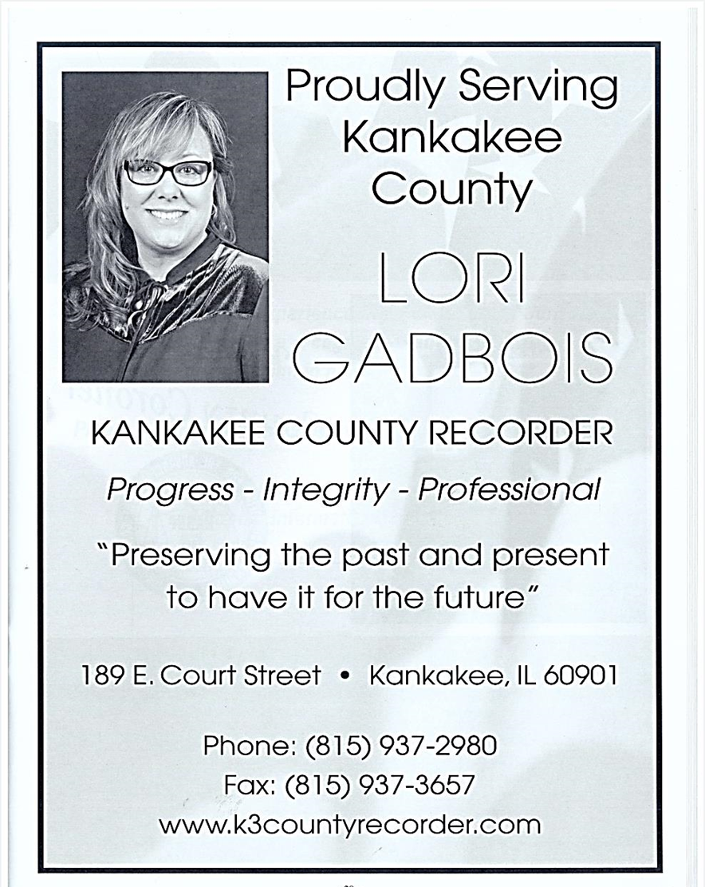

Slide 29
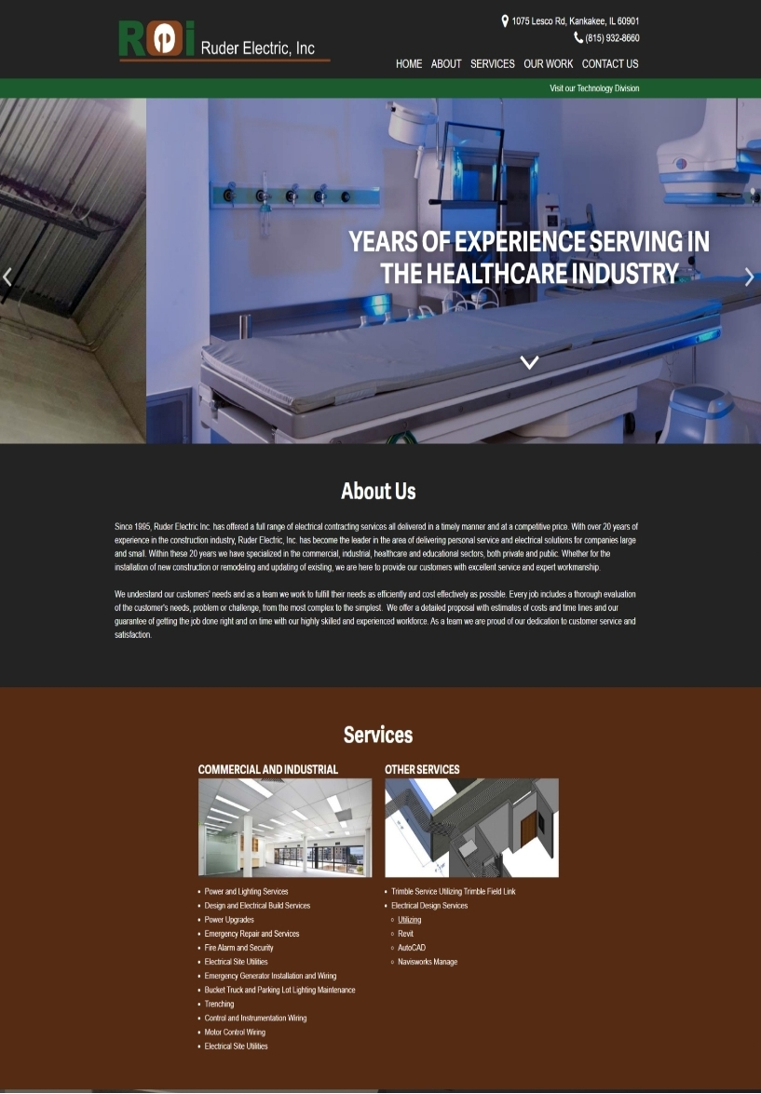

Slide 33
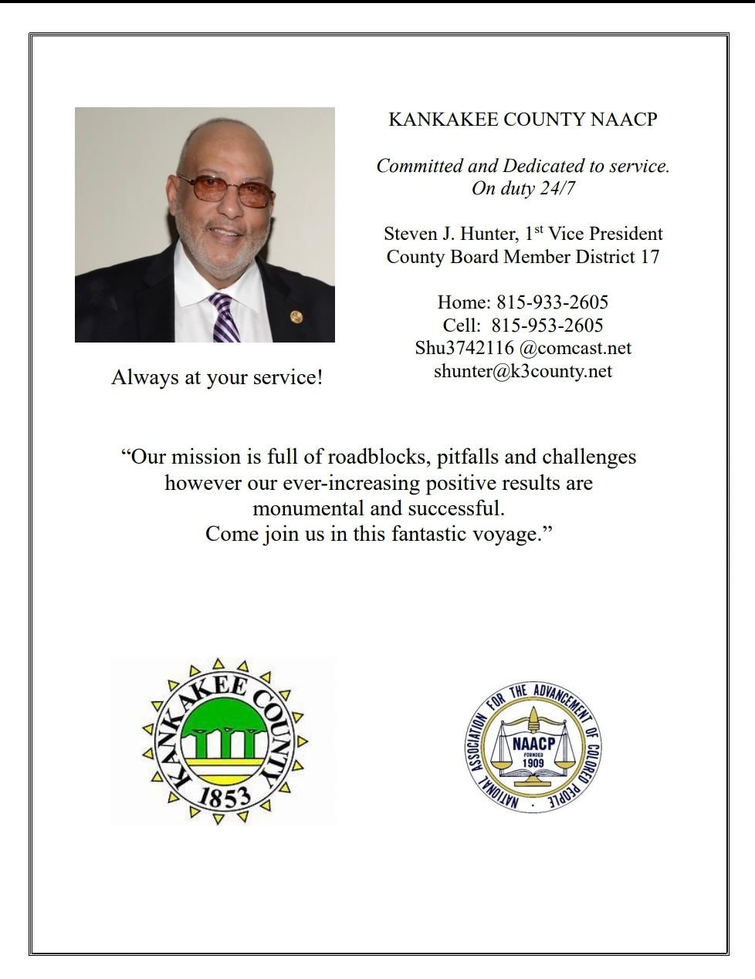

Slide 36
Arlene Mitchell-Pace
Carole Franke
Claudia Noe
Deborah Woodruff
Debra Caise
Eloise Edwards
J. Imani Drew
Jackie Haas
James Glenn
Jarman Myron Porter
Lisa Dugan
Michael Maloney
Paulette Louise Crank
Robert Ellington Snipes
Ruth Glenn
Shirley Byrd
Steven Hunter
Theodis Pace
William Copeland
Willie Pearl Burrell

Slide 37
SUBSCRIBING SILVER LIFE MEMBERS
Emile Capriotte
Heather Bryan
Lonnice Jordan
Andrew Wheeler
Cynthia Holdman
Donna Sample
Jacob Lee
Ulysses Hudson
Christopher Curtis
Quentin Hardrict
Vurnice Maloney
Jess Gathing
Mary Lacy
Adam Woodruff

Slide 41
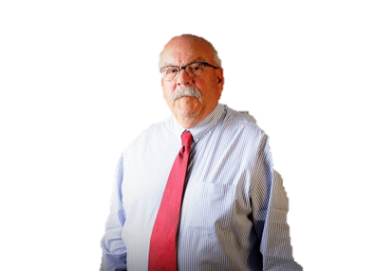
BOB GESSNER
KANKAKEE COUTY CORONER’S OFFICE
CONGRATULATES THE
KANKAKEE COUNTY NAACP
ON ANOTHER SUCCESSFUL YEAR

Slide 43
BEST WISHES
NAACP
KANKAKEE COUNTY, ILLINOIS BRANCH
ON YOUR
ANNUAL FREEDOM FUND BANQUET 2022
THANK YOU FOR MANY YEARS OF SERVICE
THE LAW OFFICE OF
KARREN S. FARMER
ATTORNEY & COUNSELOR at LAW
P. O. Box 254 Aroma Park, ILLINOIS
815-935-0100
BANKRUPTCY $900 to start
NO HIDDEN FEES OR COSTS – FREE INITIAL CONSULTATION
Stop repossessions, foreclosures, garnishments and creditor harassment
PROBATE/WILLS/ESTATES
FAMILY LAW/DIVORCE/CHILD CUSTODY
CRIMINAL LAW/TRAFFIC MATTERS
WORKERS COMPENSATION
REAL ESTATE/CONTRACTS
SMALL BUSINESS & CHURCH MATTERS

Slide 44
Half Page Supporters

Slide 46
CONGRATULATIONS NAACP

Slide 47
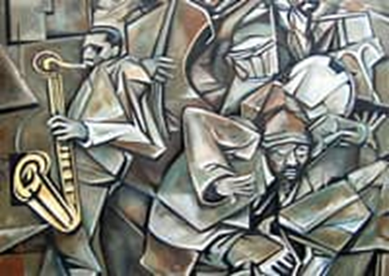
ENTERTAINMENT BY THE CHAPMAN QUARTET
To schedule an event call:
815-216-3732

Slide 51
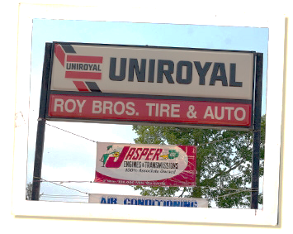
Roy Brothers Tire and Auto
Family Owned Honest Reliable Friendly
Nice people to know, Great people to do business with. Roy Brothers Tire and Auto is family owned. As such, we stress core values such as honesty, dependability, and affordability. We strive to deliver quality services; from routine oil changes to complete engine overhauls. We take pride in our work and our many satisfied customers. Established in 1969, our highly skilled technicians offer comprehensive knowledge and experience. You can be sure that your car will be handled with the latest diagnostics equipment and that everything done to your car will be explained to you in terms that you can understand. Our Services
We honor most extended warranty and service contracts.
Air Conditioning Alternators Batteries Brakes Computer Diagnostics
Computerized Wheel Alignment Electrical Systems Engine Repair and Replacement Fleet Maintenance Fuel Injection Specialists Mufflers and Exhaust Oil and Lube Radiators Shocks and Struts Suspension Starters Tires Towing Transmissions Tune-Ups Wheel Balancing

Slide 53
Scholarship Recipients
Jalen Townsend
Sydney Ramsey

